Slide 1

WAY TO ENTERPRISE
Java Basics
VTI ACADEMY
Author: duy.nguyenngoc1@vti.com.vn
March 2020

Slide 2
Agenda
Constructor
Package
Access Modifier
OOP
Assignments
Copyright © VTI Academy All Rights Reserved

Slide 3
Constructor
Purpose: Init Object
Multiple Constructors
Default Constructor: no parameter

Slide 4
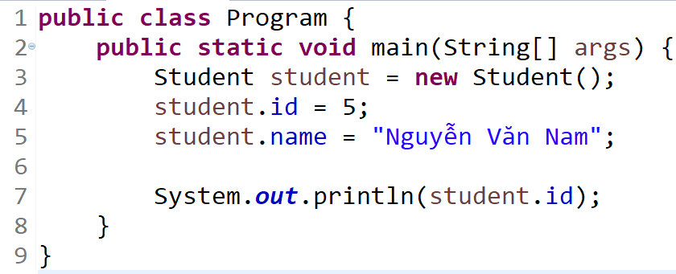
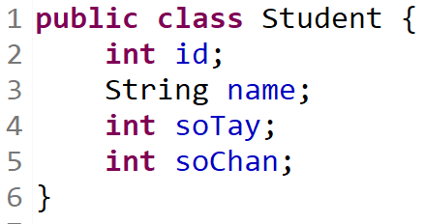
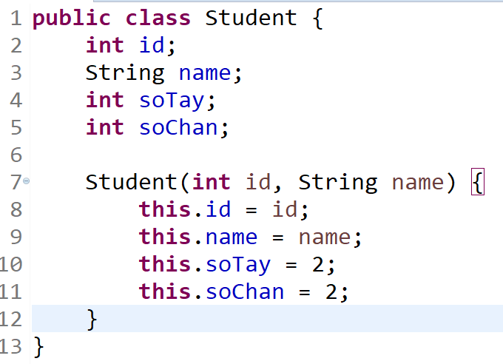
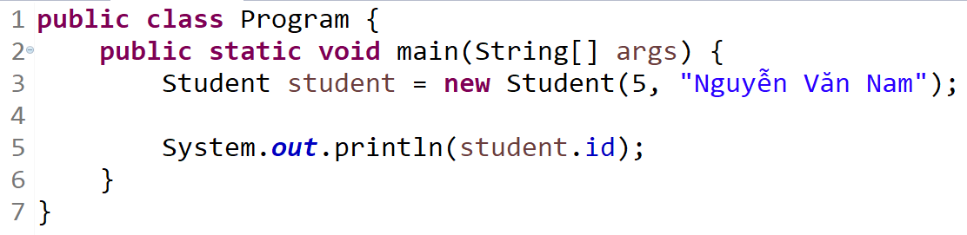
Example

Slide 5
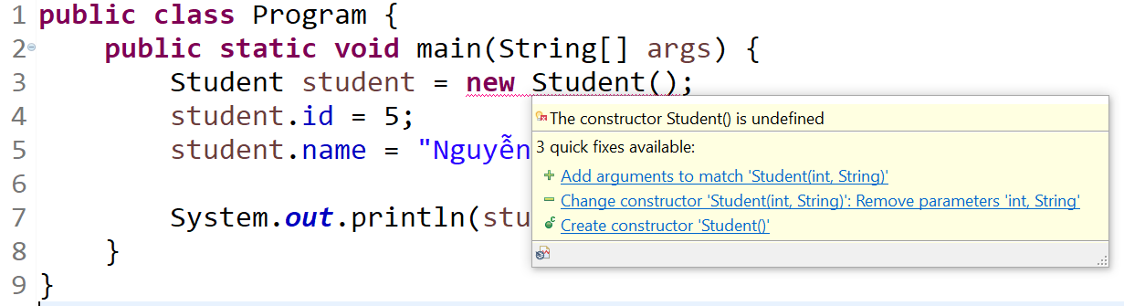
Example

Slide 6
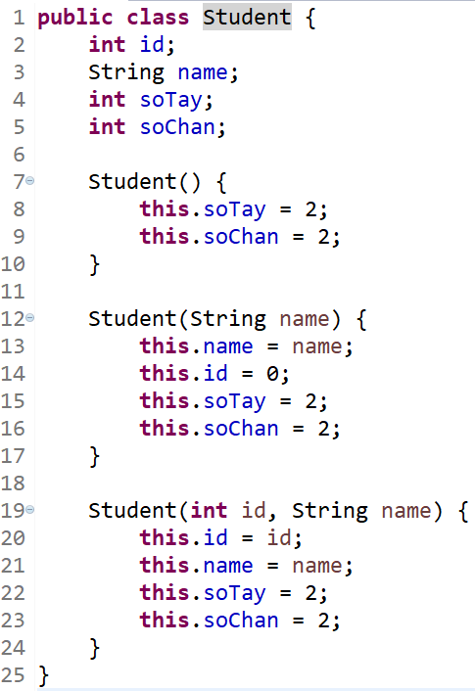
Example

Slide 7
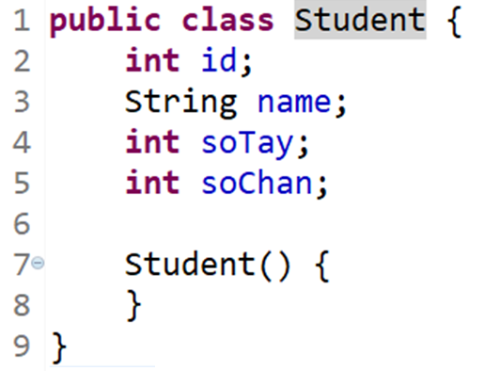
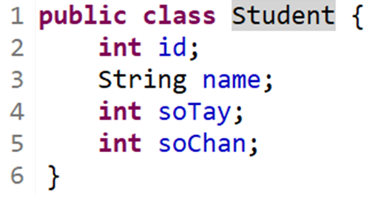
Default Constructor

Slide 8
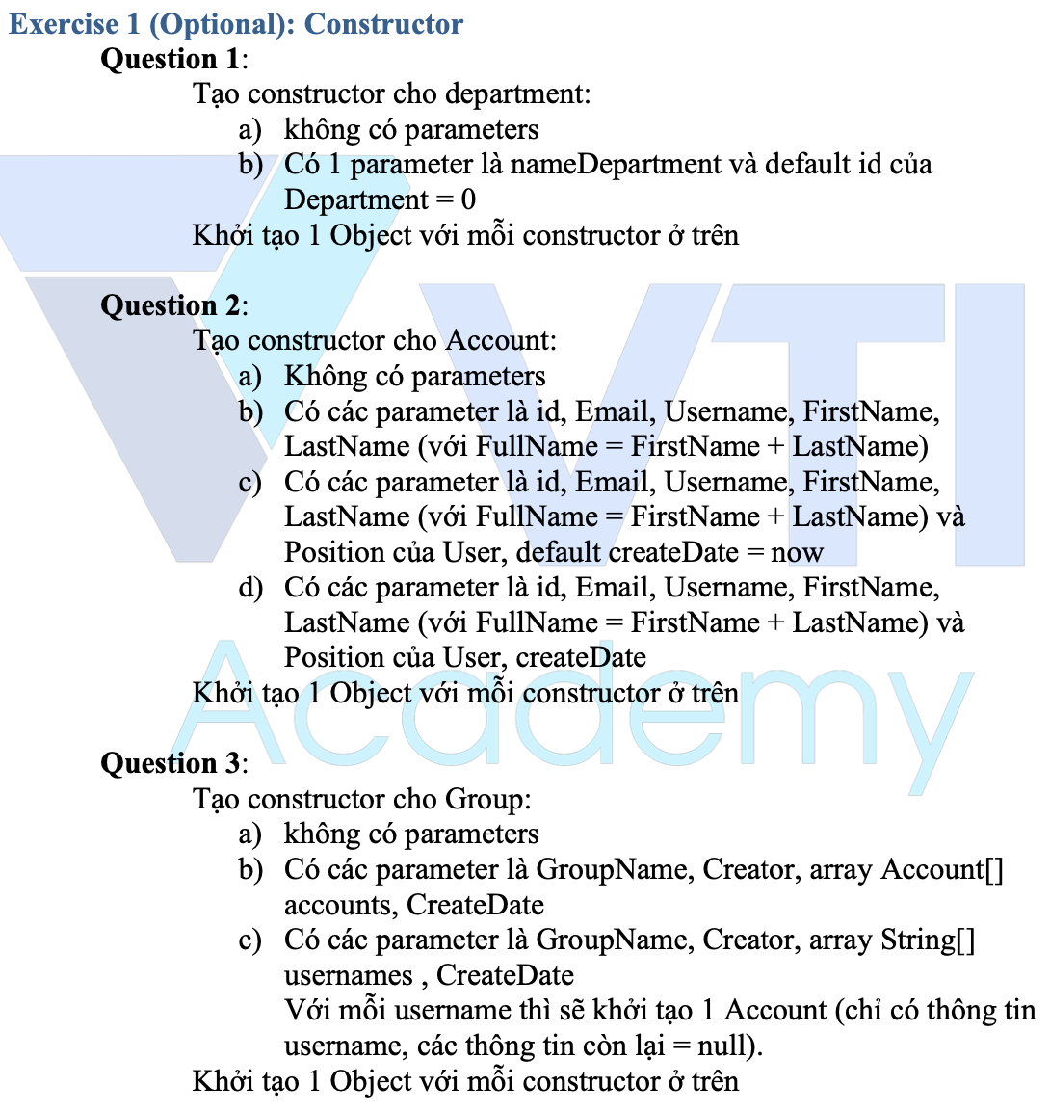
Testing System Assignments
Exercise 1 (Optional): Constructor

Slide 9
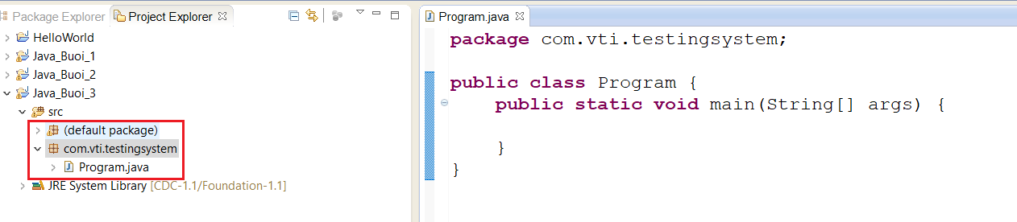
Package

Slide 10
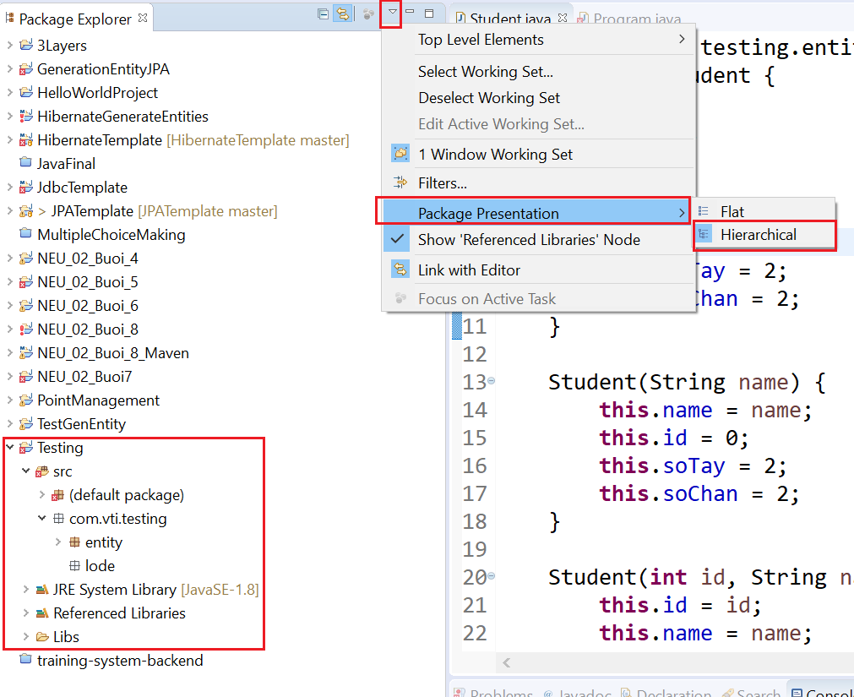
Package

Slide 11
Testing System Assignments
Exercise 2: Package

Slide 12
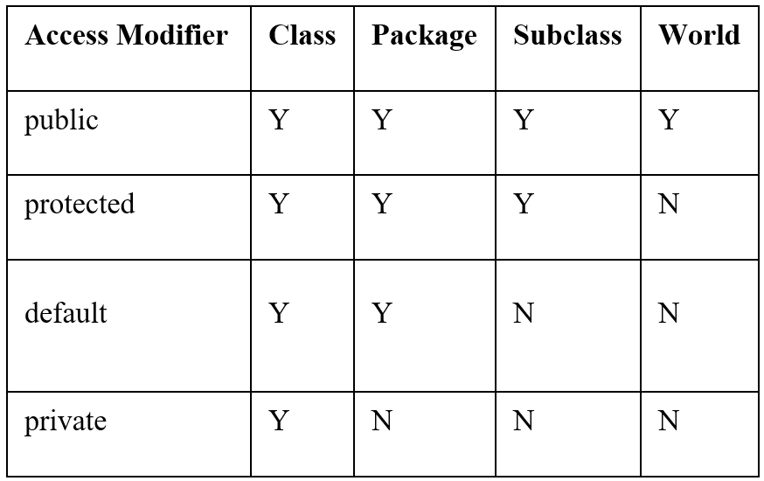
Access Modifier
Class, constructor, method, property

Slide 13
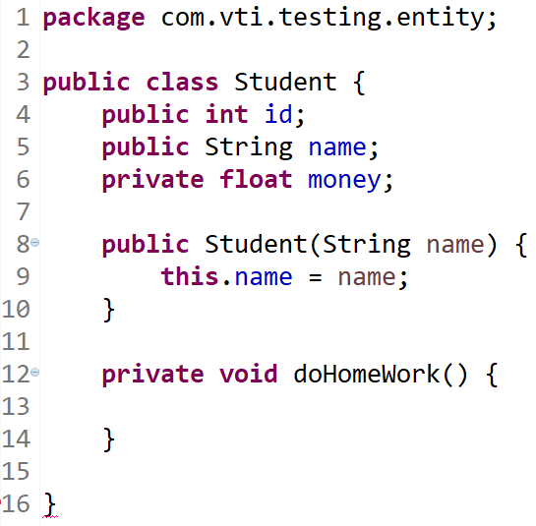
Example

Slide 14
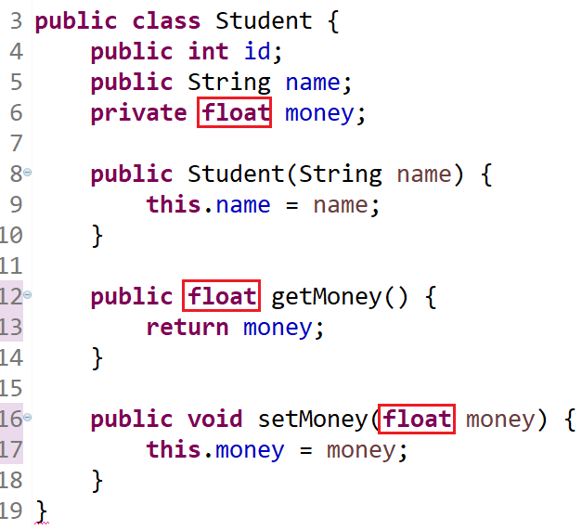
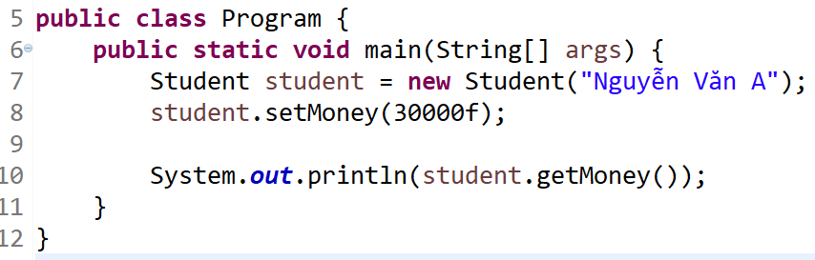
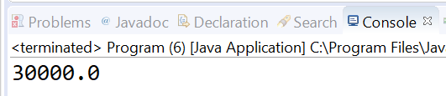
Getter & Setter

Slide 15
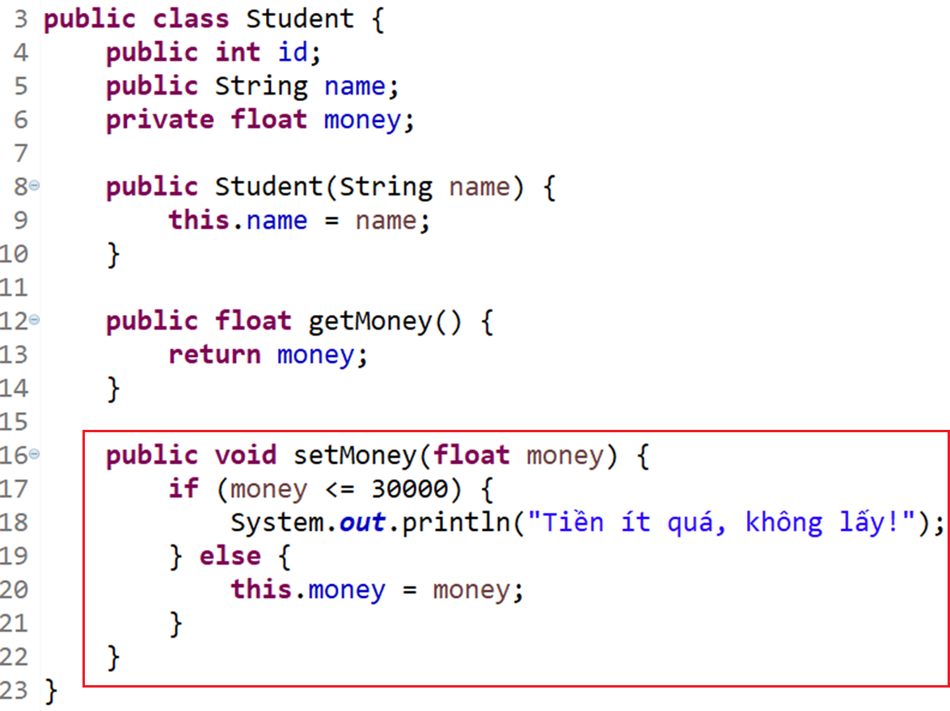
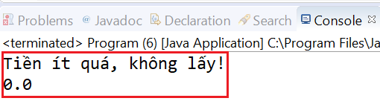
Getter & Setter

Slide 16
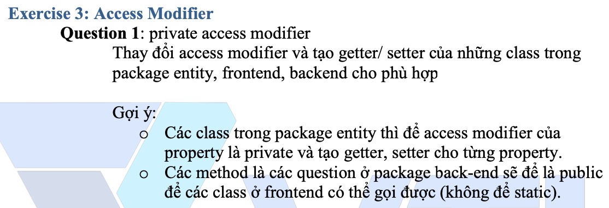
Testing System Assignments
Exercise 3: Access Modifier

Slide 17
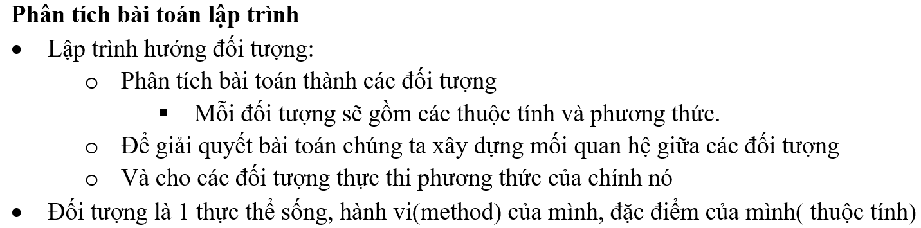
OOP

Slide 18
4 Properties
Encapsulation (đóng gói)
Inheritance (kế thừa)
Abstraction (trìu tượng)
Polymorphism (tính đa hình)

Slide 19
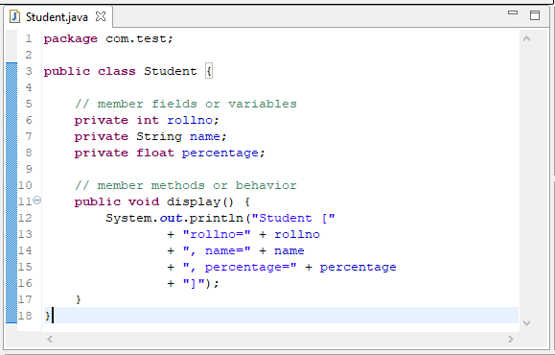
Encapsulation
Access modifier: Private
Getter / Setter

Slide 20
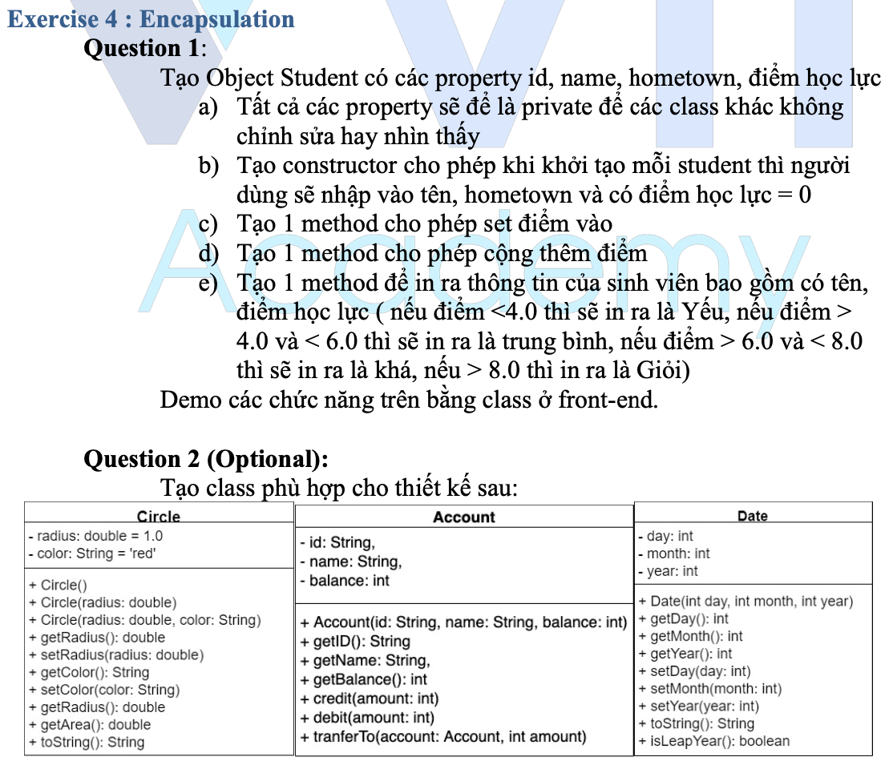
Testing System Assignments
Exercise 4 : Encapsulation

Slide 21
Inheritance
Keyword: Extend
Multi level inheritance
Direct superclass (1 level)
Indirect superclass (2 level)
Single inheritance

Slide 22
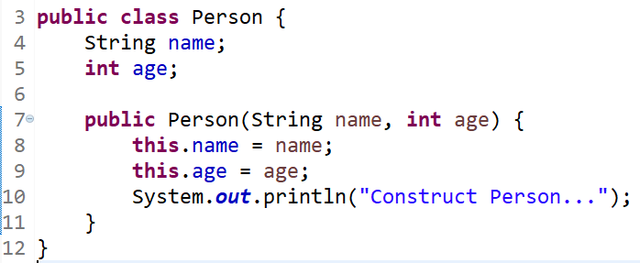
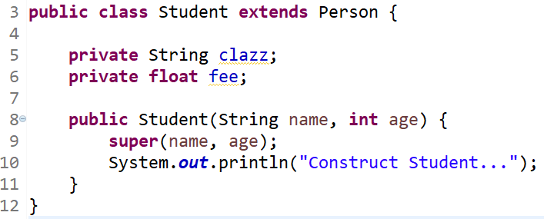
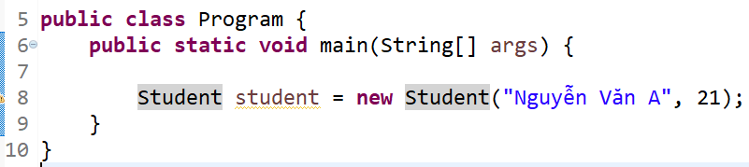
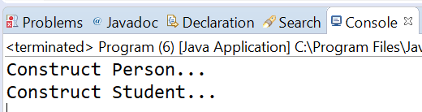
Constructor Inheritance
Init constructor from child to parent

Slide 23
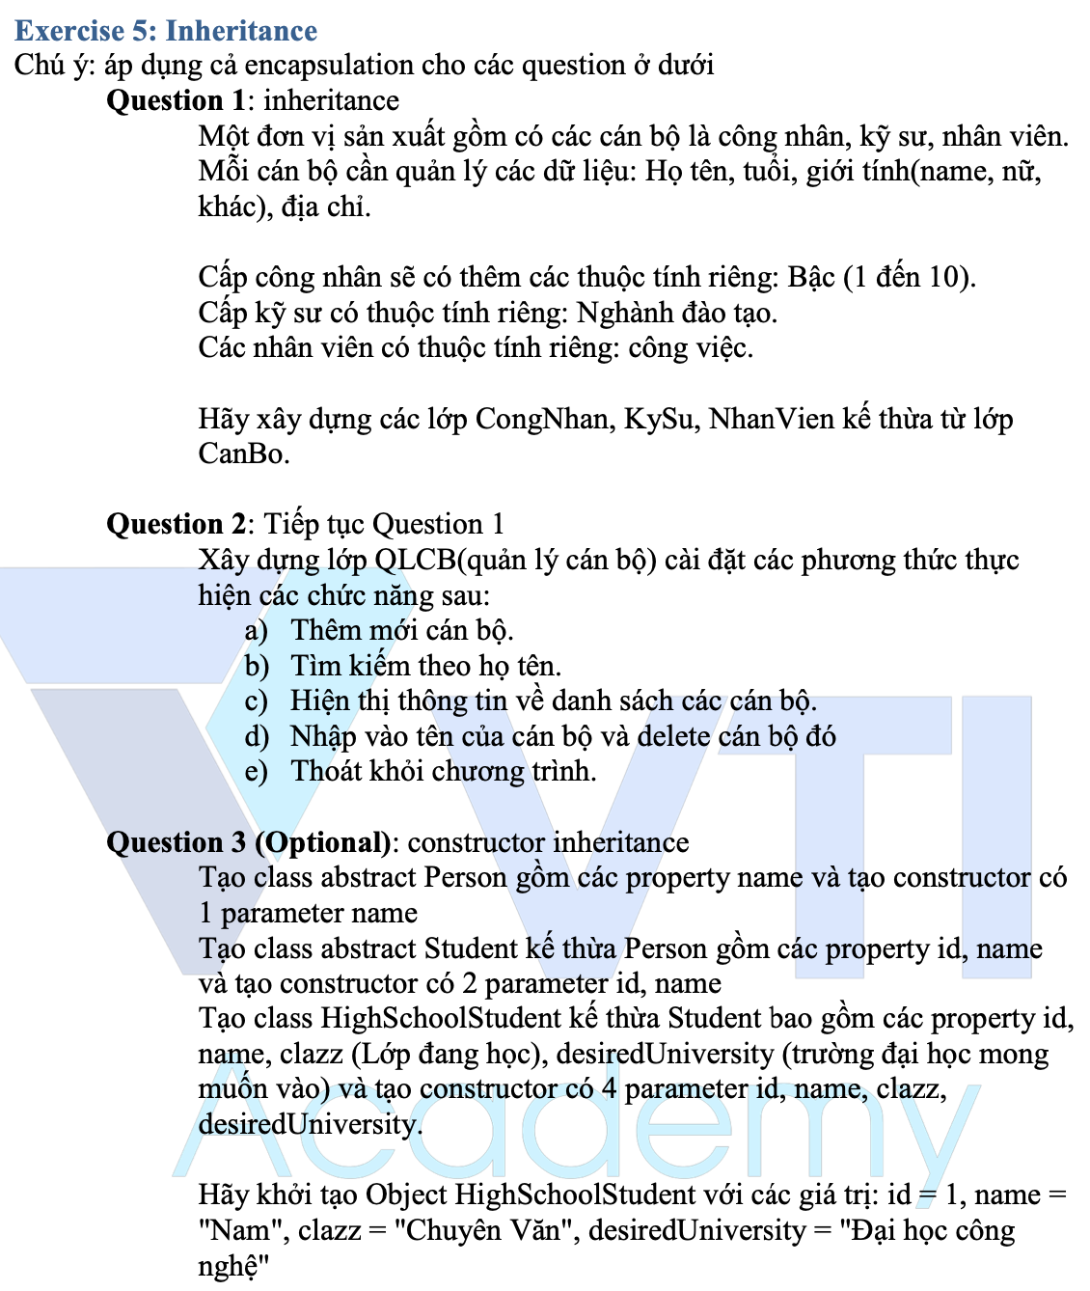
Testing System Assignments
Exercise 5: Inheritance

Slide 24
Abstraction
Abstract class
Interface

Slide 25
Abstract class
Is object but not completed yet
abstract class, abstract method

Slide 26
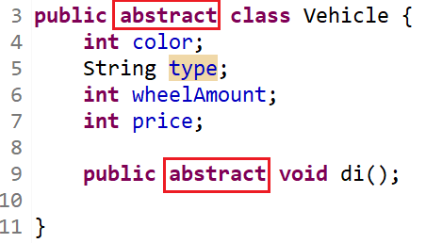
Example

Slide 27
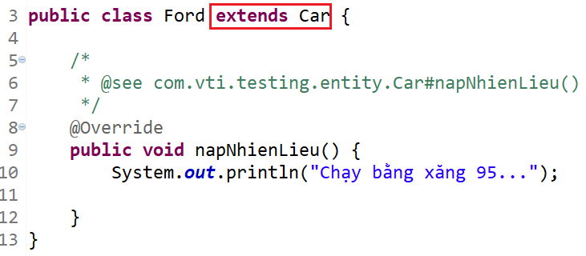
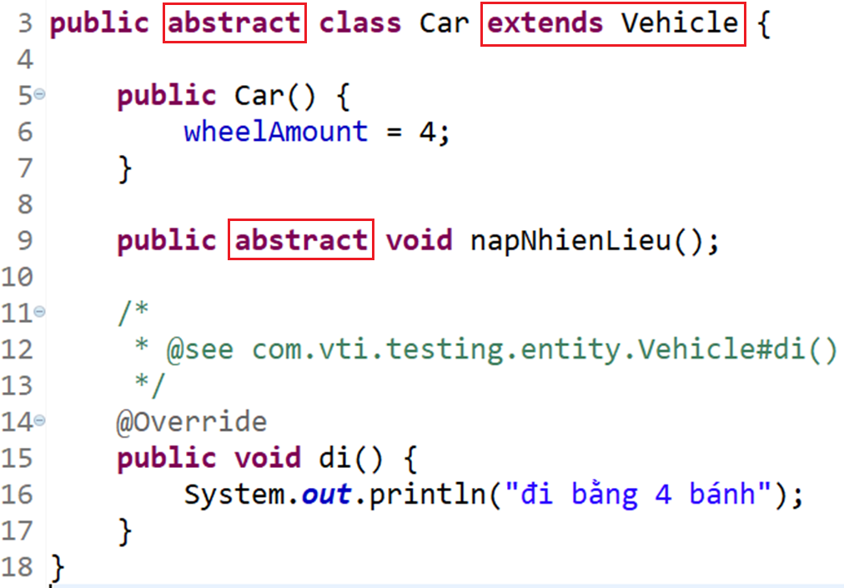
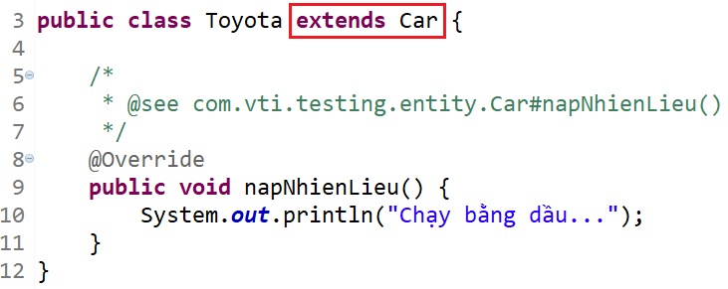
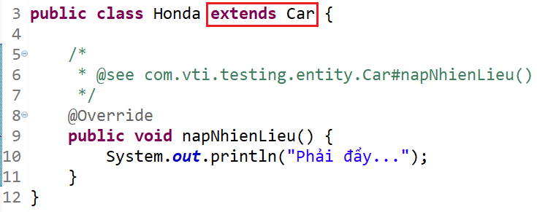
Example

Slide 28
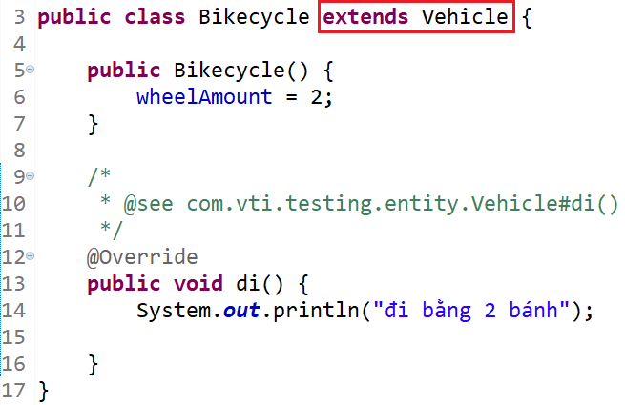
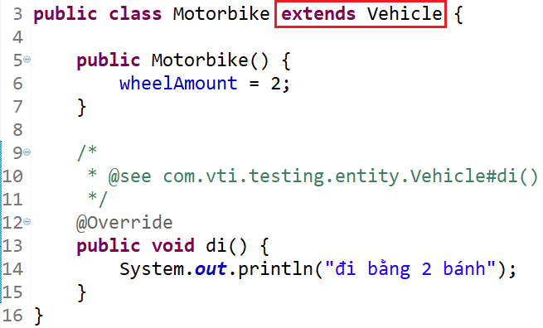
Example

Slide 29
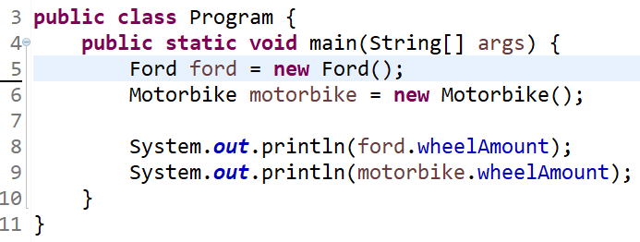
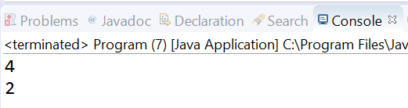
Example

Slide 30
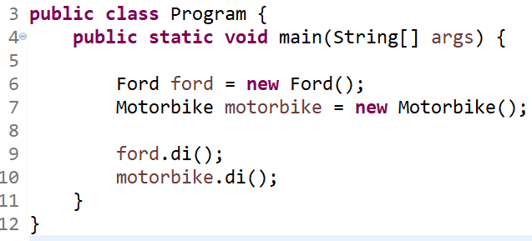
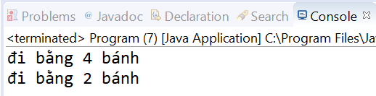
Example

Slide 31
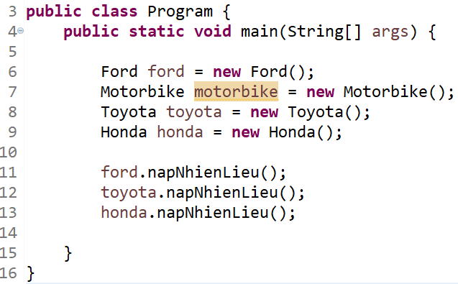
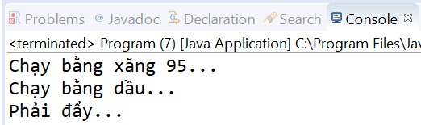
Example

Slide 32
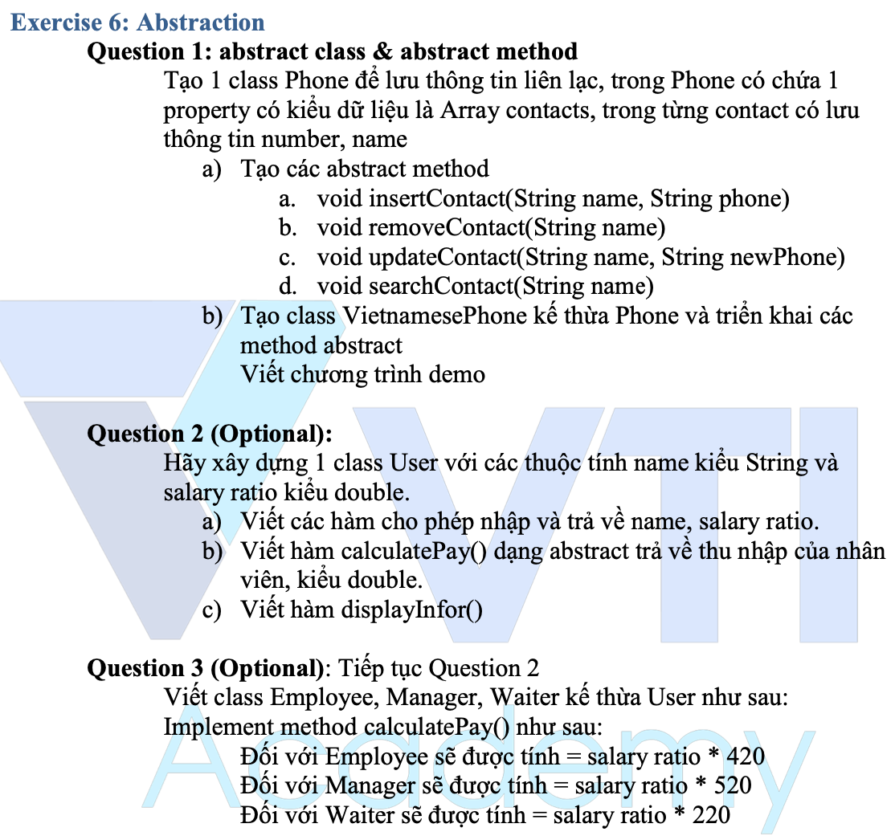
Testing System Assignments
Exercise 6: Abstraction

Slide 33
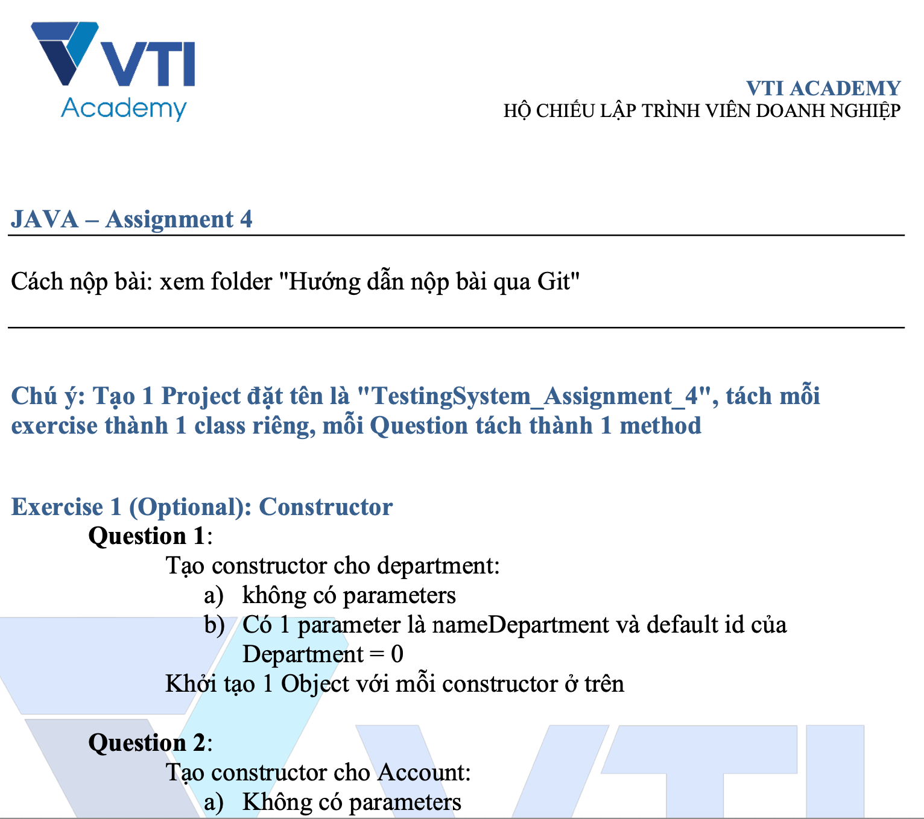
Testing System Assignments

Slide 34
Q & A
Copyright © VTI Academy All Rights Reserved

